Slide 1
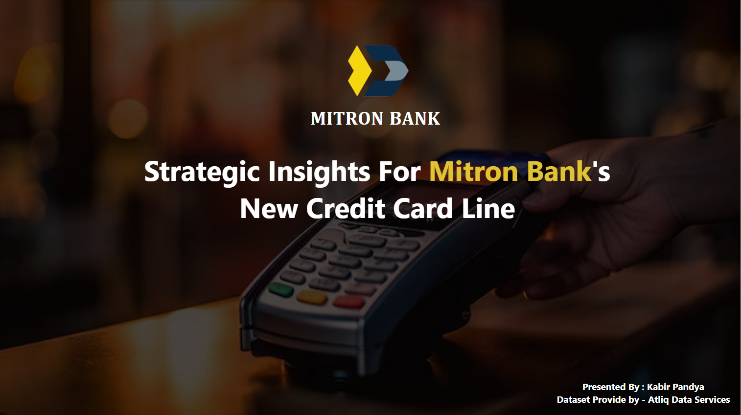

Slide 2
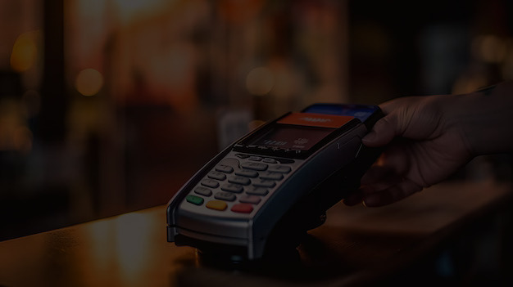
Agenda
Problem Statement
Goal
Dashboard Showcase
Insights
Recommendation

Slide 3
Problem Statement
Mitron Bank wants to launch a new credit cards to expand its services, but there is uncertainty to address this , I, As a Data Analyst, I need to analyze a sample dataset of 4000 customers online spending and habits across five cities. The Goal is to provide insights that help Mitron Bank tailor the credit cards to customer needs and Market Trends

Slide 4
Goal
My Goal is to analyze the sample data, Create impactful metrics and visuals, and develop a user-friendly dashboard to Mitron Bank’s leadership. The Objective is to deliver data-driven recommendation to Mr. Bashnir Rover, Supporting the successful launch of new credit card line

Slide 5


Slide 6
INSIGHTS
Top Spending Areas
Whether it’s setting bills, getting groceries, buying electronics or taking care of health and wellness, these are the big spenders.
Mumbai is the go-to-city for spending across different ages – it’s the spending champ!
Age and Spending Style
Folks between 25-34 and 21-24 up for a good time, spending more on stuff like entertainment, Clothes and Travel.
Those Over 45 are a bit more frugal, especially when it comes to swiping the credit card.

Slide 7
INSIGHTS
Jobs And Money Talk
People with regular IT Jobs , business owners , and others with a monthly paycheck are the big earners and spenders.
Freelancers and Government employees are also not shy when it comes to opening the wallet.
Gender and Relationship Impact
Guys are more likely to flash credit cards than the ladies.
Married folks are big spenders compared to single- Unmarried ones.

Slide 8
INSIGHTS
Cities Specific Spending
Mumbai isn’t just a city of dreams ; it’s also the city of spending especially with credit cards.
Other Places like Delhi NCR’s, Bengaluru, and Chennai have their own unique spending vibes depending on the age group.
Diving Into Categories
Bills, electronics, and travel are golden areas for credit card perks- tailor those rewards for the big spenders.

Slide 9
Recommendations
Targeted Offers
25-34 : Diverse offers in Electronics, Entertainment, and Travel.
21-24 : Youth-centric deals in Entertainment, Apparel, and Travel.
Mumbai : Increased rewards or points on Bills, Groceries, Electronics, and Health & Wellness. Specialized travel benefits.
Salaried IT : Higher credit limits.
Business Owners : Business-oriented rewards.
Males : Targeted rewards for Electronics, Travel, and other high- value categories.
Married : Family-centric offers like discounts on outings, groceries, or bills.

Slide 10
Recommendations
Category-Specific Features
Bills : Special Cashback or points on utility bills.
Electronics : Flexible Payments plans or EMI option.
Travel : Exclusive travel-related offers, discount or rewards.
Additional Market Research
Rewards Points for on-time bill payments.
Bill Payment reminder 3 days prior.

Slide 11
Thank
You!

